Slide 1
Accessible Workflows
for Collecting & Preserving
Human Rights Video Evidence
No Time to Wait Symposium
London, 26 Oct 2018
Yvonne Ng, Senior Archivist, WITNESS
yvonne@witness.org | @ng_yvonne

Slide 2
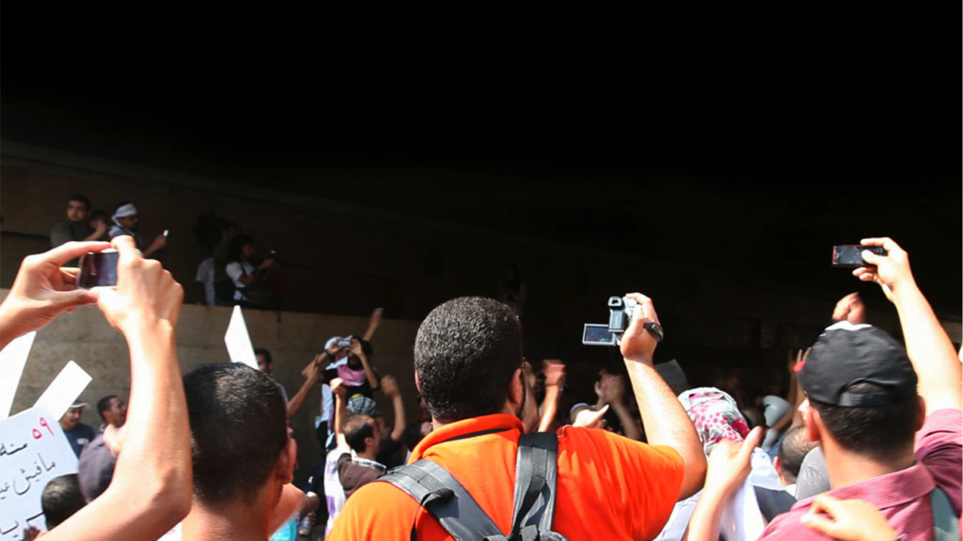
WITNESS trains and equips human rights defenders around the world to use video and technology to expose abuses and fight for justice and lasting change.

Slide 3
Accessible Workflows for Collecting & Preserving Human Rights Video Evidence
Human rights video evidence examples
WITNESS collaborations
  Community documentation of police violence in the US
  Social media documenting state violence against Rohingya in Burma
Gaps / needs

Slide 4
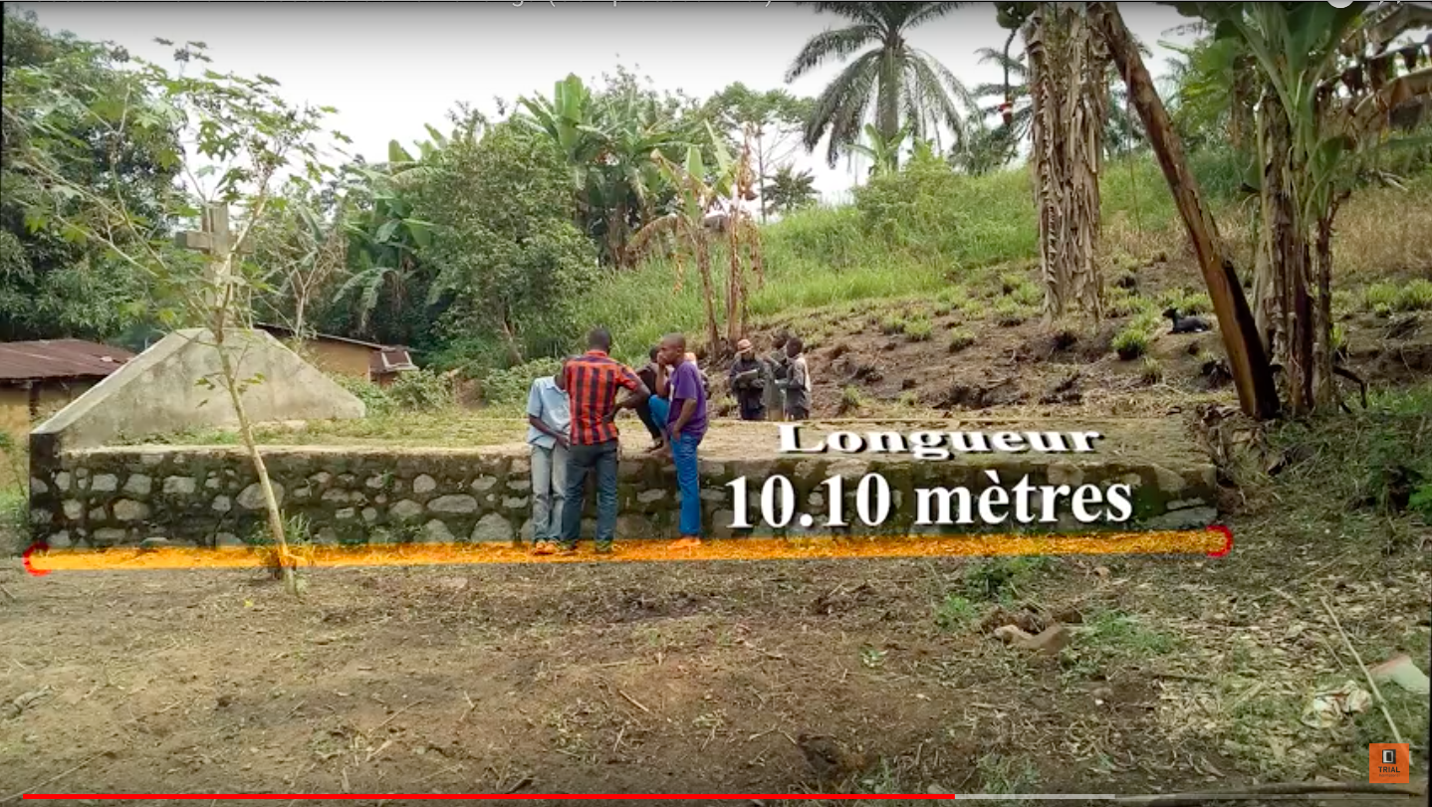
Video evidence example: DRC military tribunal

Slide 5
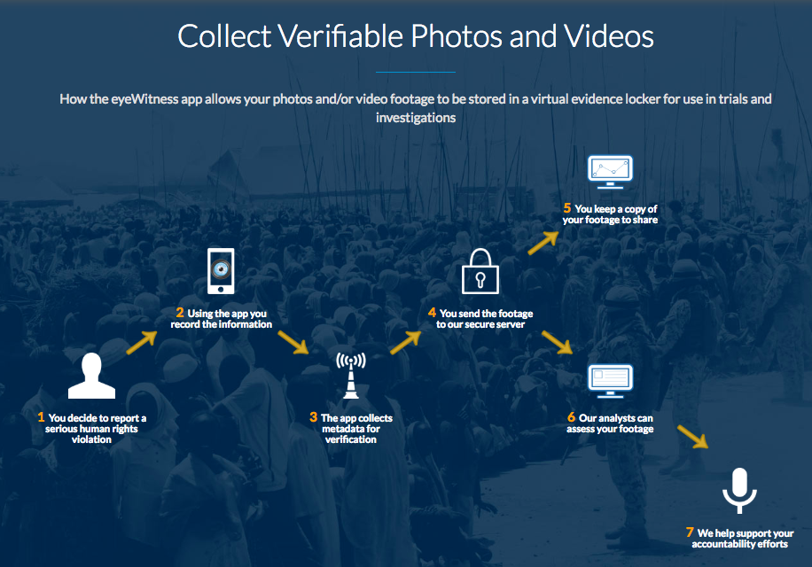
Source, Eyewitness to Atrocities, https://www.eyewitnessproject.org/

Slide 6
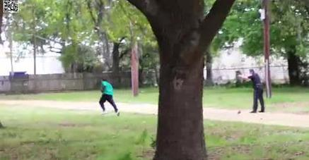
Video evidence example: Walter Scott case

Slide 7
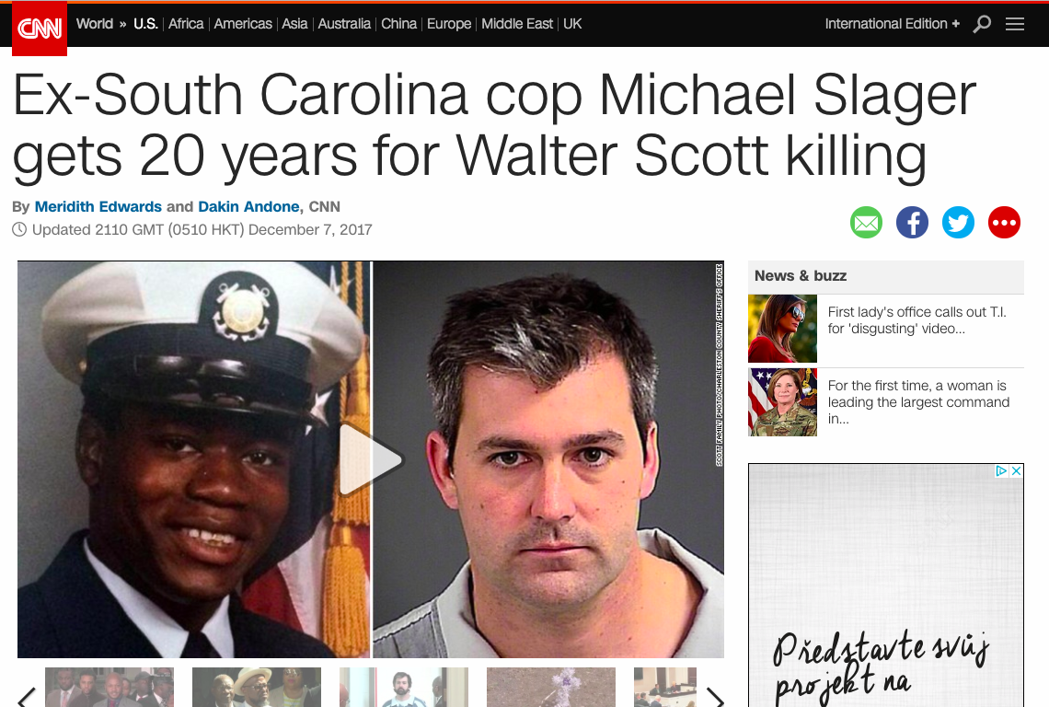

Slide 8
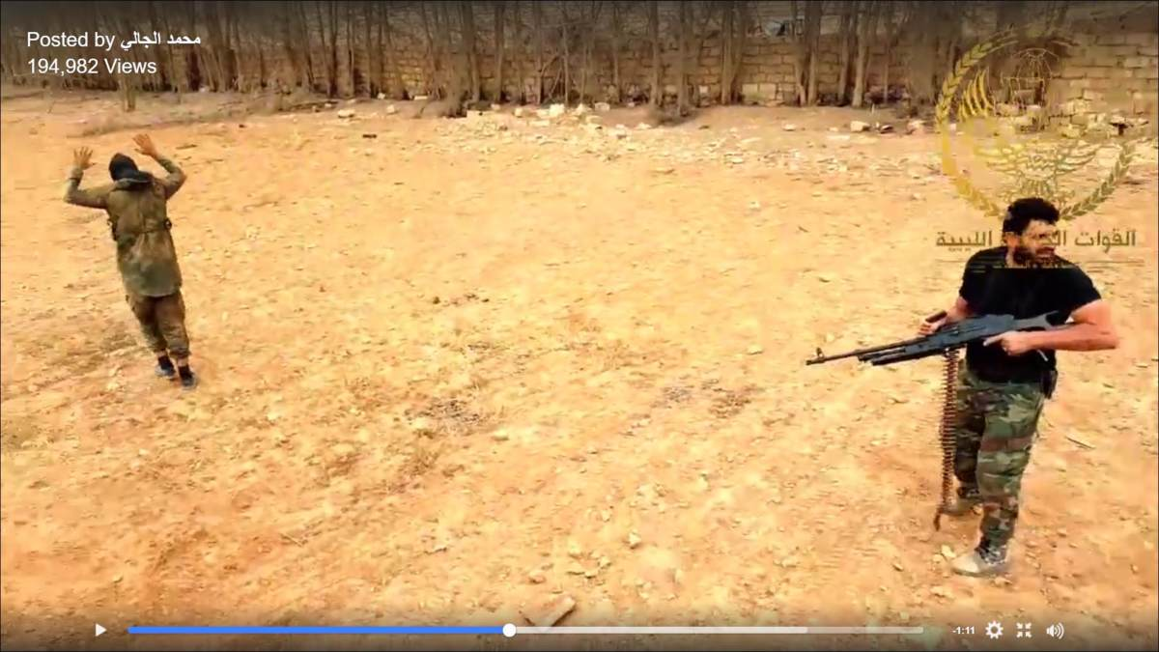
Video evidence example: War crimes arrest warrant
Source: https://www.bellingcat.com/news/mena/2017/09/04/geolocating-libyas-social-media-executioner/

Slide 9
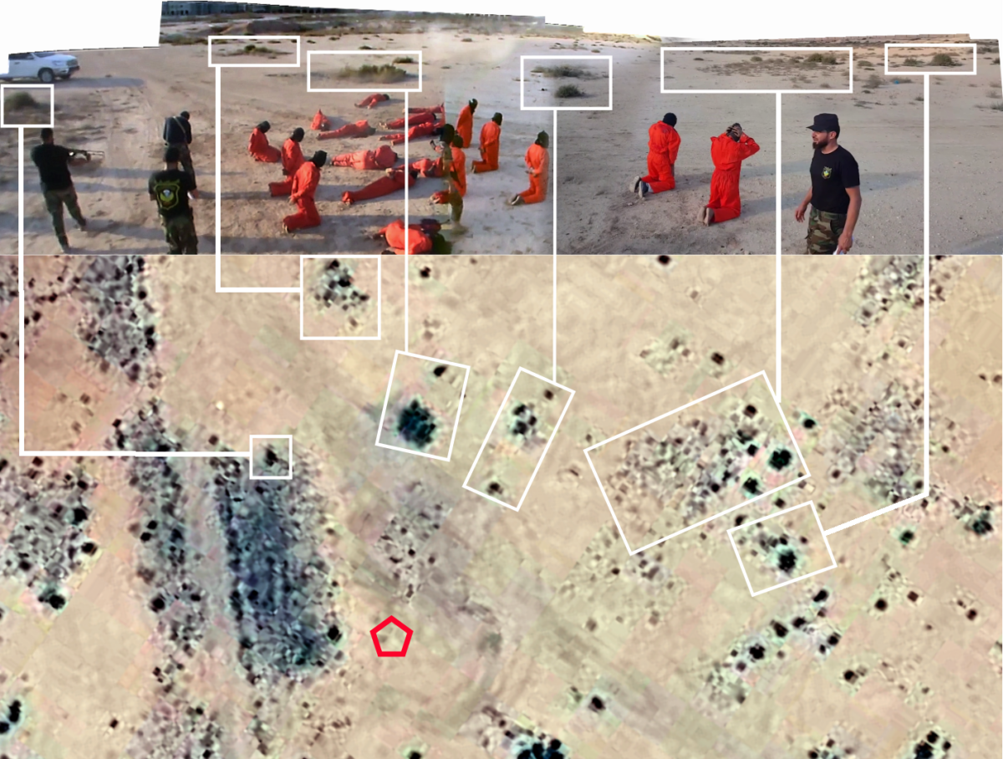
Source: Bellingcat: How a Werfalli Execution Site Was Geolocated, https://www.bellingcat.com/news/mena/2017/10/03/how-an-execution-site-was-geolocated/

Slide 10



Projects
Profiling the Police: Archiving community documentation of police misconduct in the US.
Rohingya Genocide Archive: Archiving social media of state violence against Rohingya in Burma.

Slide 11
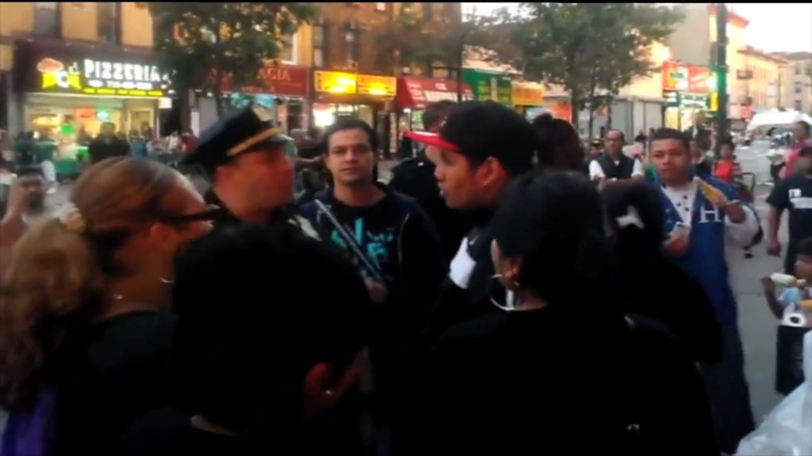
Profiling the Police

Slide 12
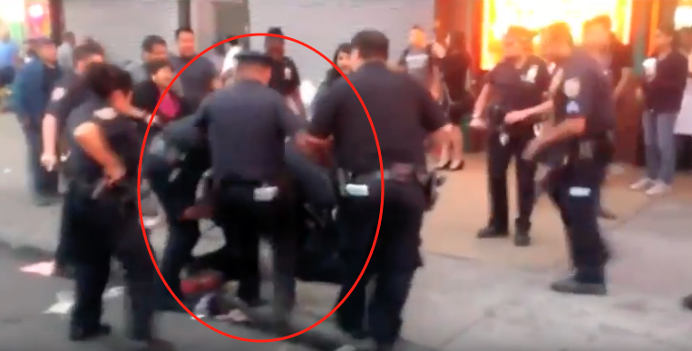
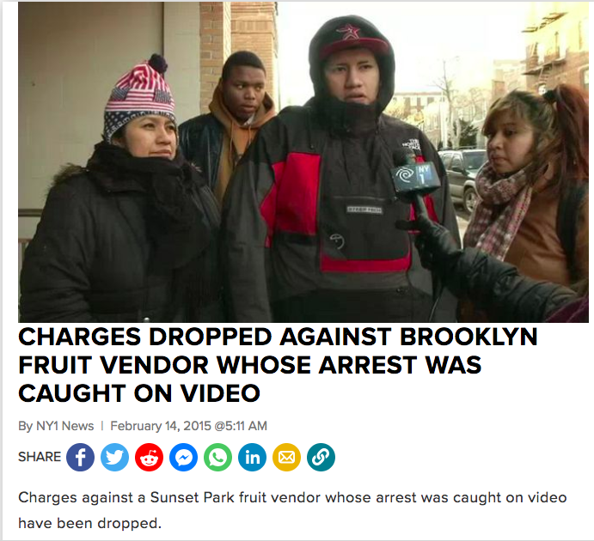
Profiling the Police

Slide 13
Archiving El Grito’s video collection
Planning.
Collecting /selecting videos.
Capturing miniDV tapes.
Processing and ingesting video files to storage.
Description, developing basic cataloging scheme.
Using videos and other public information to create officer timelines.

Slide 14
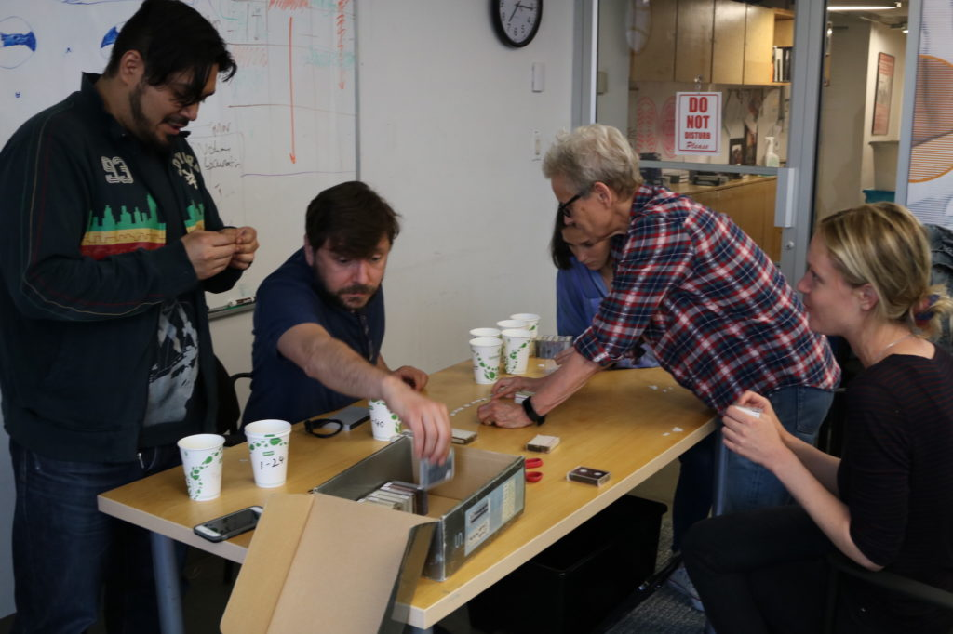

Slide 15
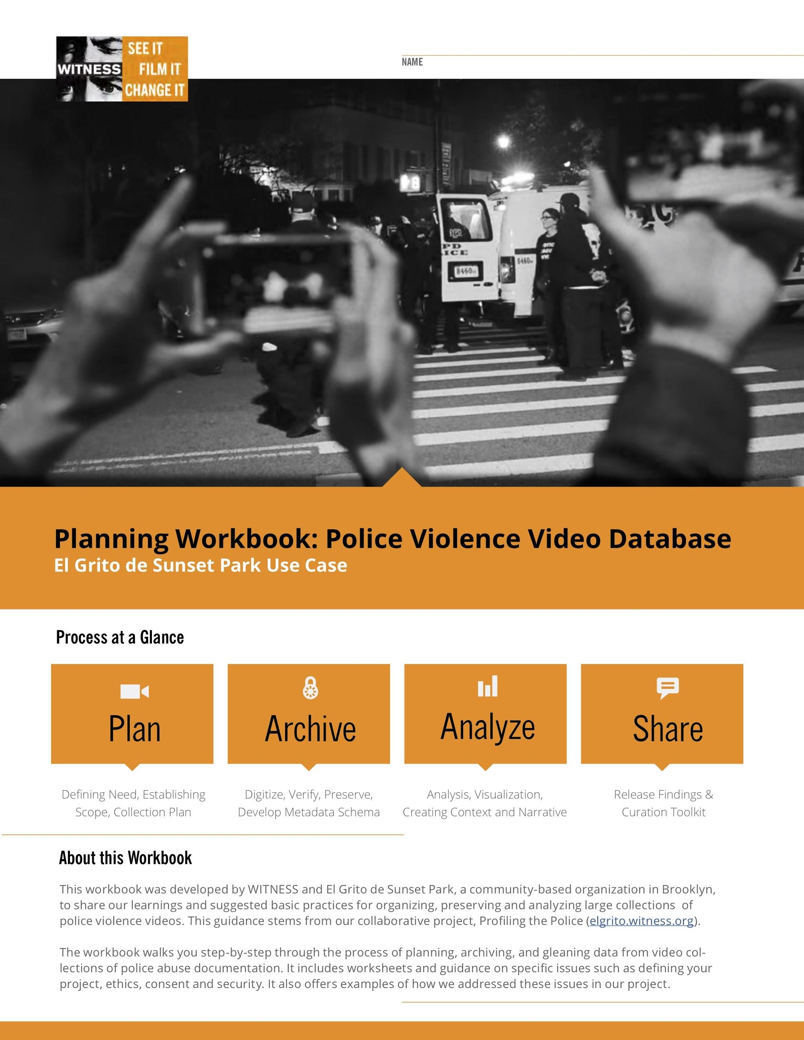
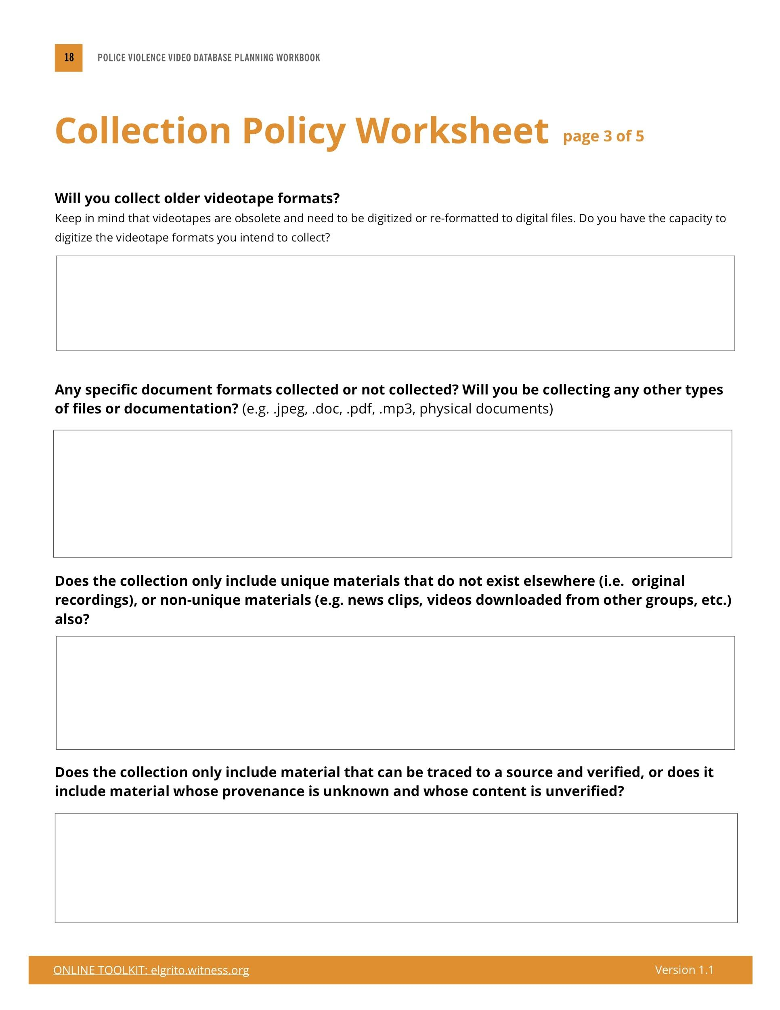
El Grito - Collection planning
Planning Workbook
https://elgrito.witness.org/

Slide 16

















El Grito - Pre-ingest
Virus scan
Copy
Sync to workspace
Inventory
Selection
Google apps script by mesgarpour
Inventory
Capture
Compress and Stitch
Sync to workspace
Handbrake

Slide 17





El Grito - Ingest and Description
Exactly (BagIt)
+

Slide 18
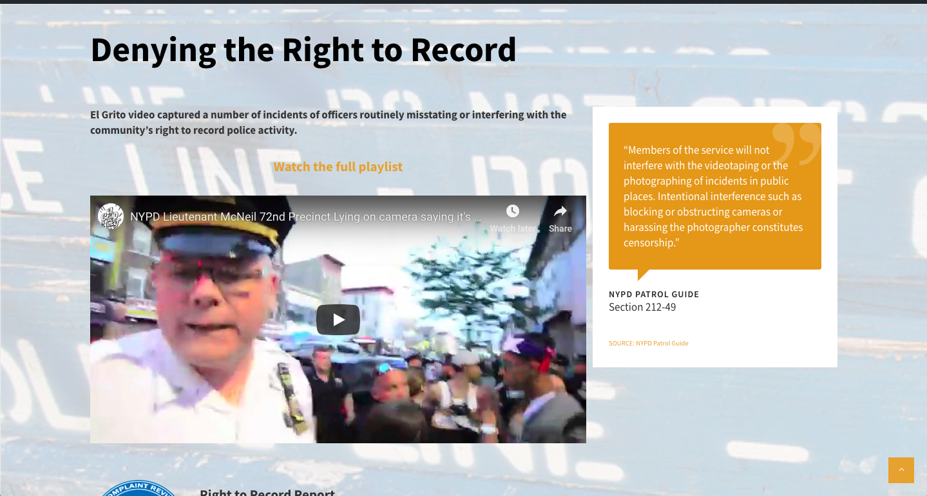
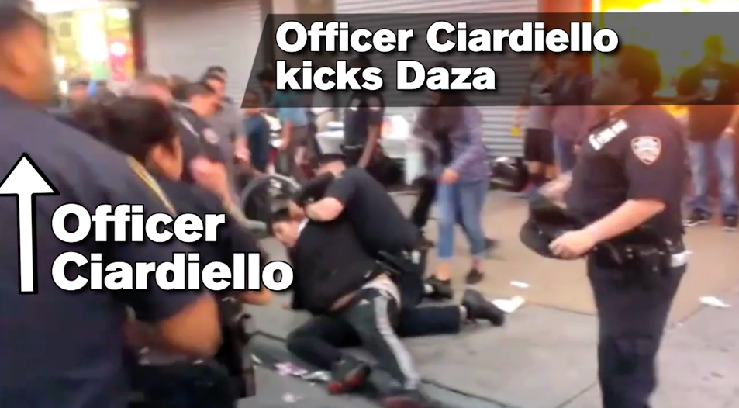
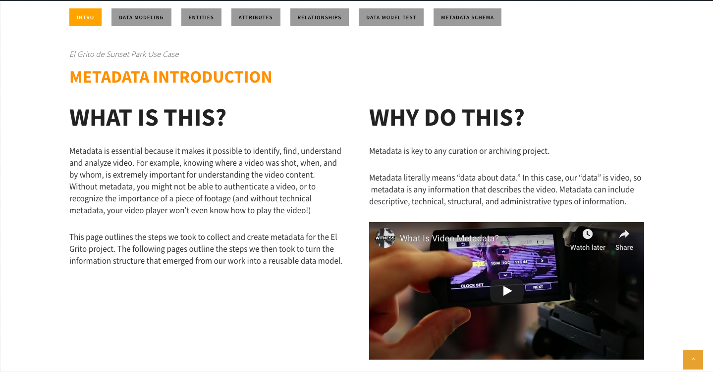
elgrito.witness.org
Advocacy information
Sample officer timeline
Workflow toolkit

Slide 19
Part 2: Berkeley Copwatch database
Started in 1990, co-founded by Andrea Prichett.
Regular copwatch patrols, Peoples’ Investigations, Know Your Rights trainings, UC Berkeley DeCal class.

Slide 20
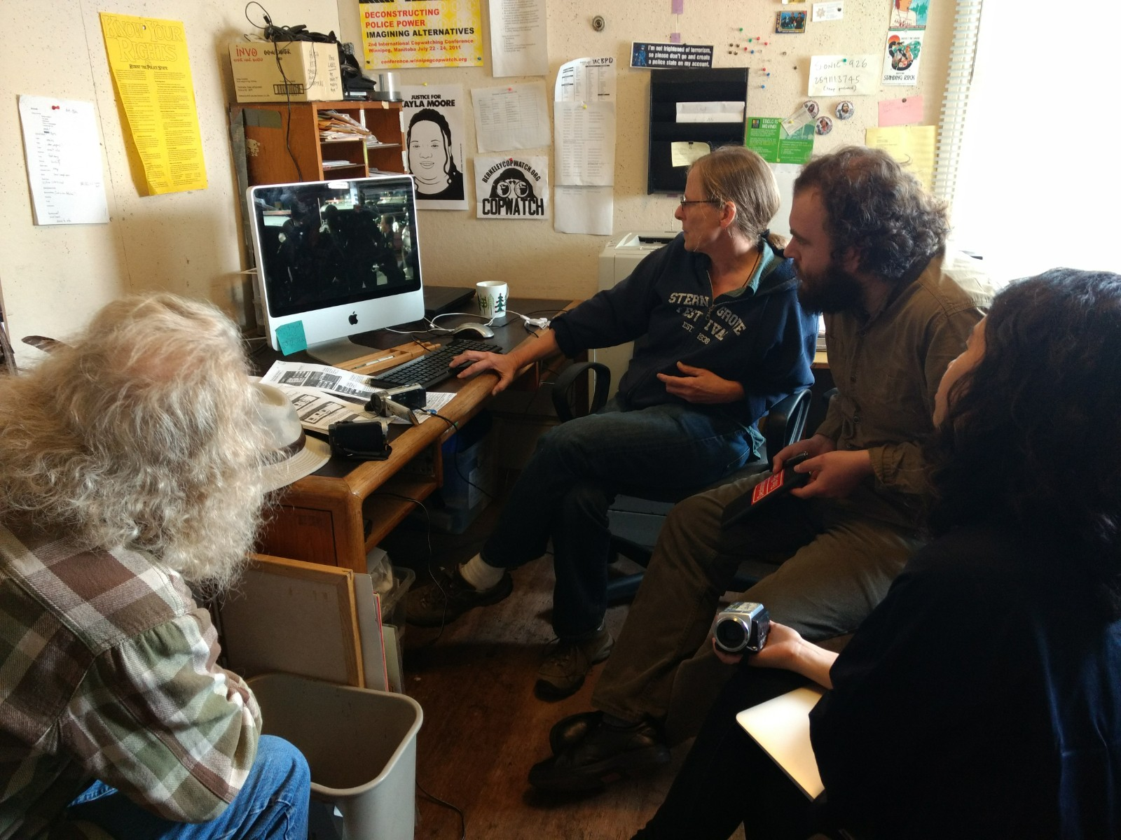

Slide 21
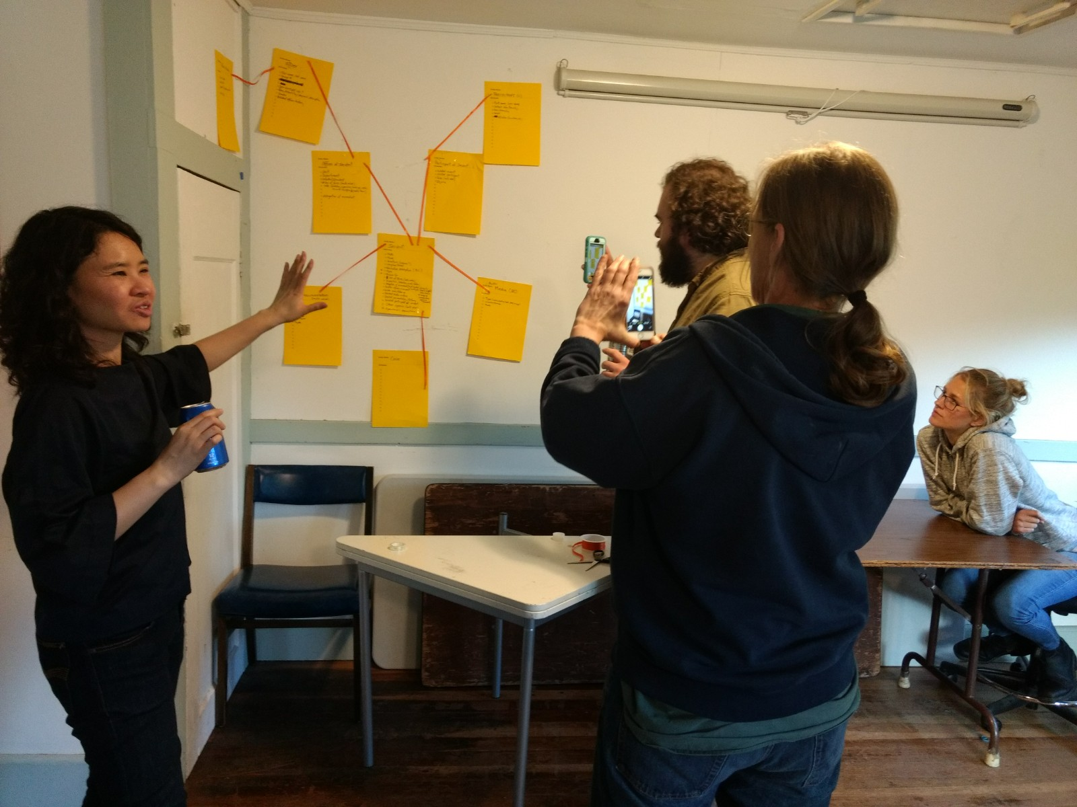
Berkeley Copwatch database project
Clarifying video collection policy.
Re-design database with end uses in mind, with more structure, and better documentation.
Streamlining video ingest workflows from camera --> storage, and input to database.

Slide 22

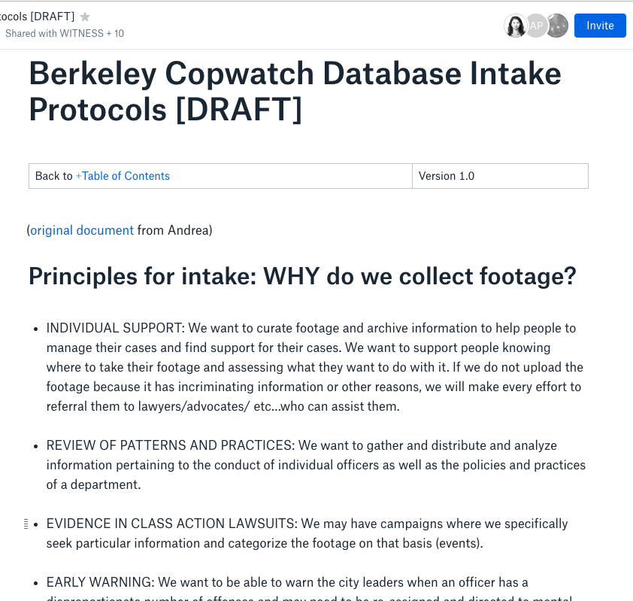
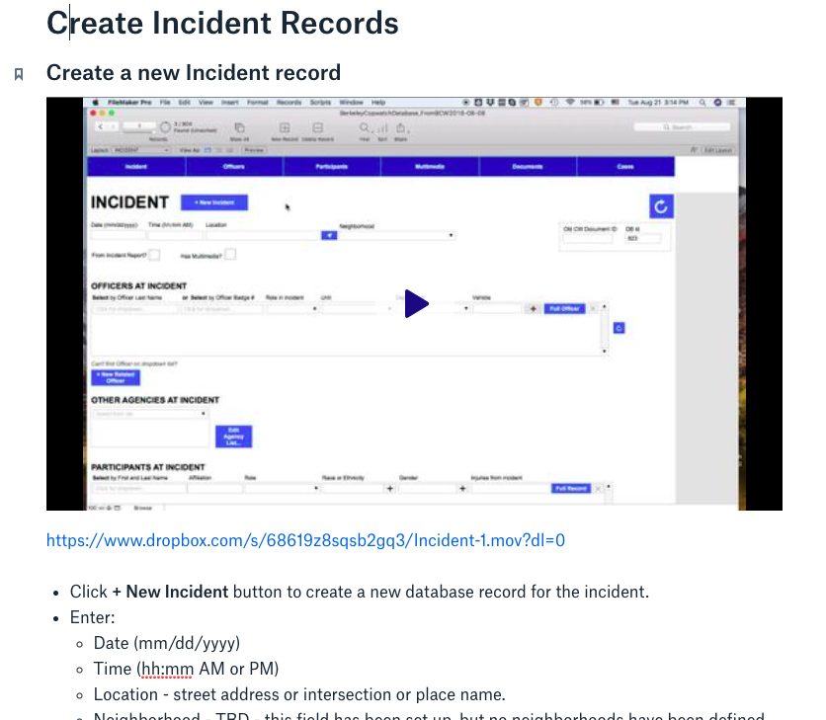
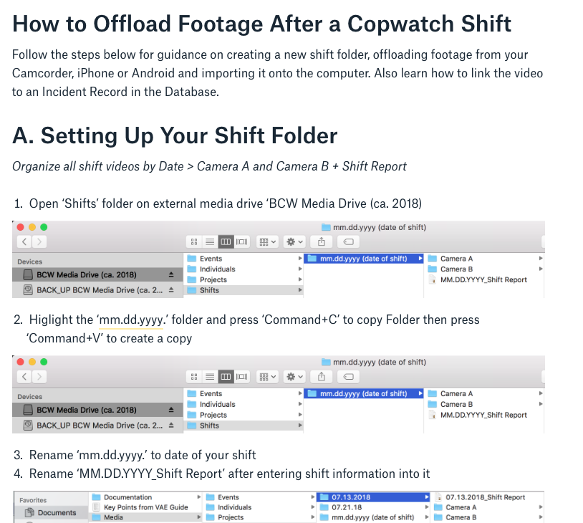
Where we’re at now
Collaborative Workflow documentation

Slide 23
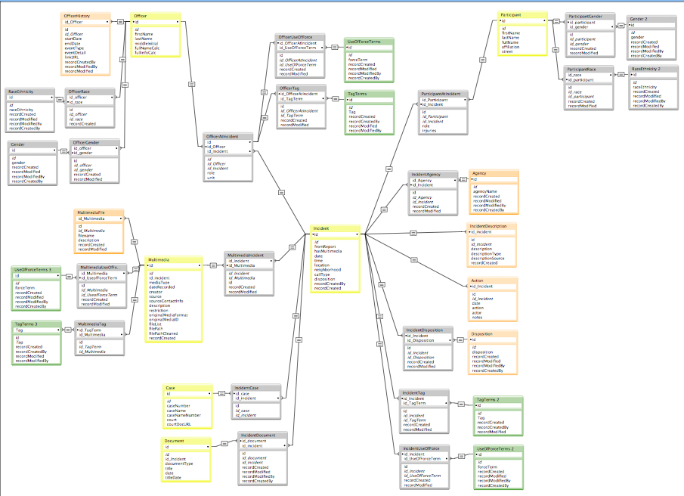
New database
For information about officers, participants, incidents, videos, other documentation, follow up actions
Filemaker - pros and cons

Slide 24
Rohingya Genocide Archive
Working with a Rohingya organization in SE Asia to establish sustainable Rohingya-led archive.
Collect and preserve video and social media documentation of genocide and crimes against humanity against Rohingya people for purposes of investigation, accountability, justice, and truth-telling.

Slide 25
Background
Rohingya people - marginalized and persecuted stateless minority in Burma.
Numerous crackdowns by military using horrific violence, including on 25 Aug 2017 “clearance operation”.
Major humanitarian crisis - thousands killed, missing; 700,000 Rohingya have fled.
UN Fact Finding Mission recommends investigation and prosecution of Burmese military for crimes against humanity, war crimes and genocide.
Preliminary examination at ICC underway on Rohingya forced deportation to Bangladesh.

Slide 26
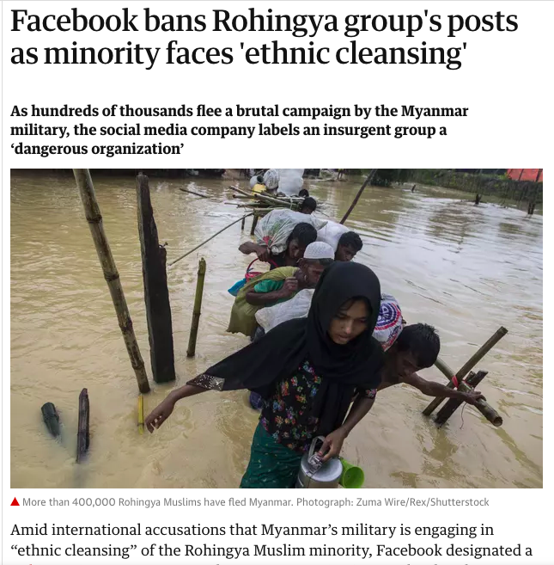
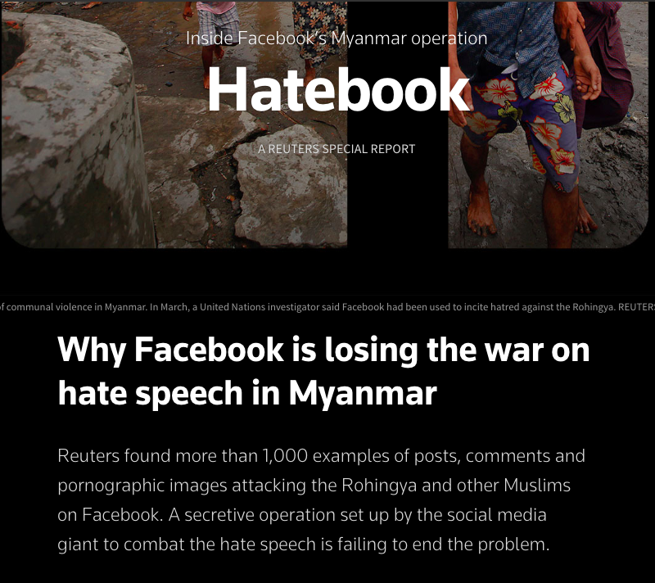

Slide 27
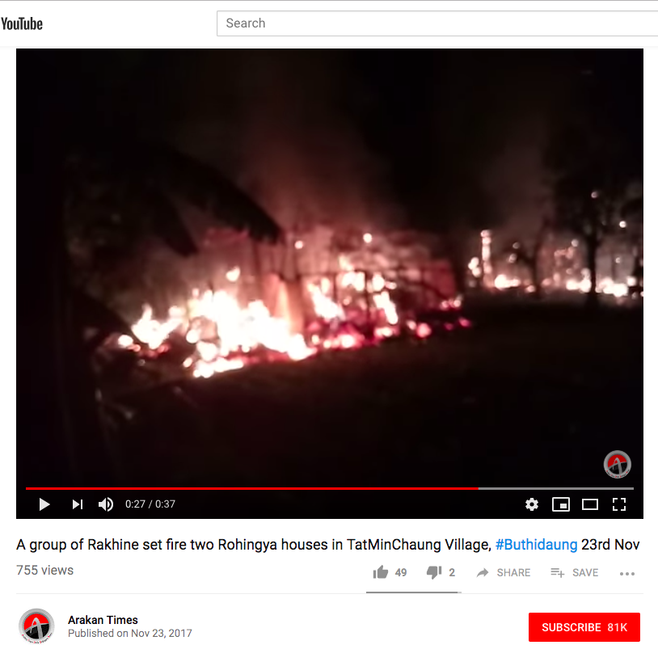
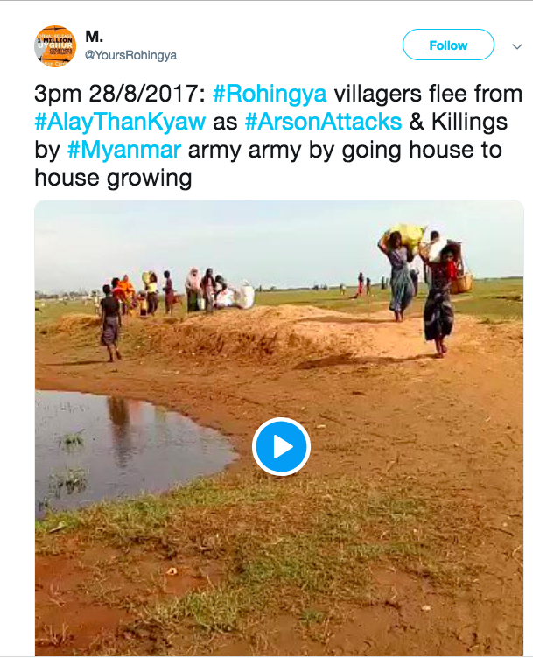
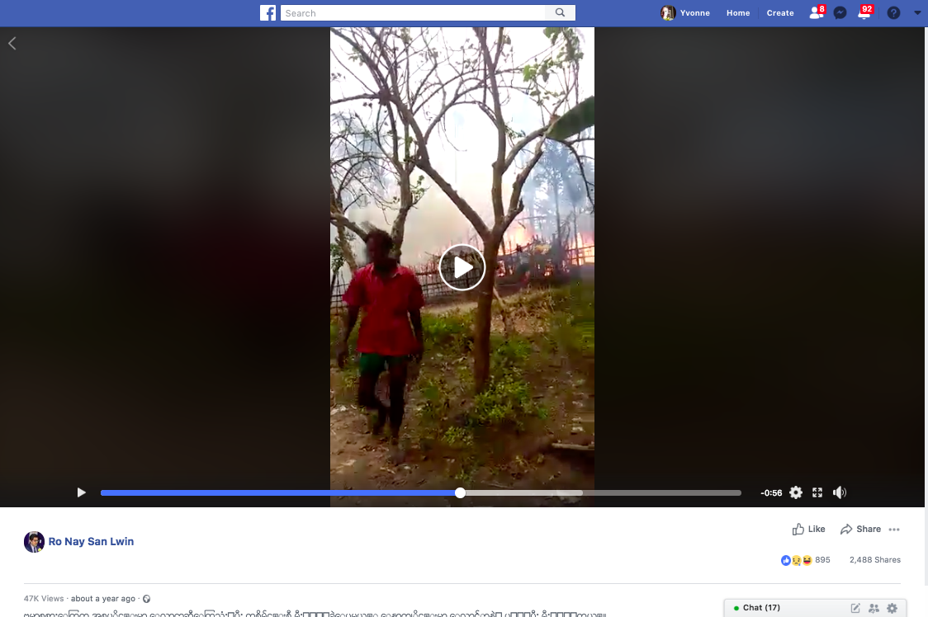

Slide 28









RGA Collecting Workflow
FB GRaph API Explorer
+ Curl
Twurl
youtube-dl --id --write-info-json --format best
YouTube Data API Explorer
Youtube.videos.list service
+ CURL
Built-in “Export Chat” button, “Attach media”
Built-in “Export Chat” button (phone) +
Download from desktop app

Slide 29
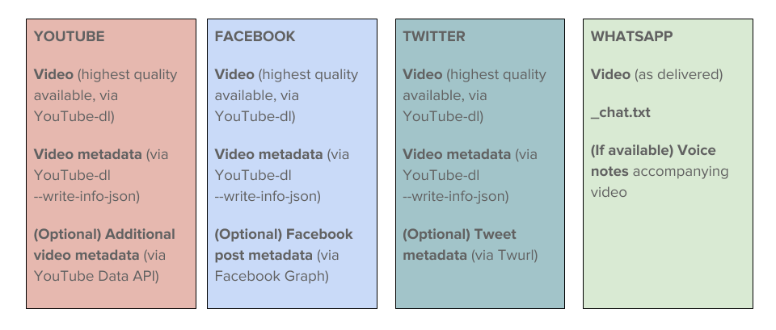
RGA Collecting Workflow
Exactly

Slide 30
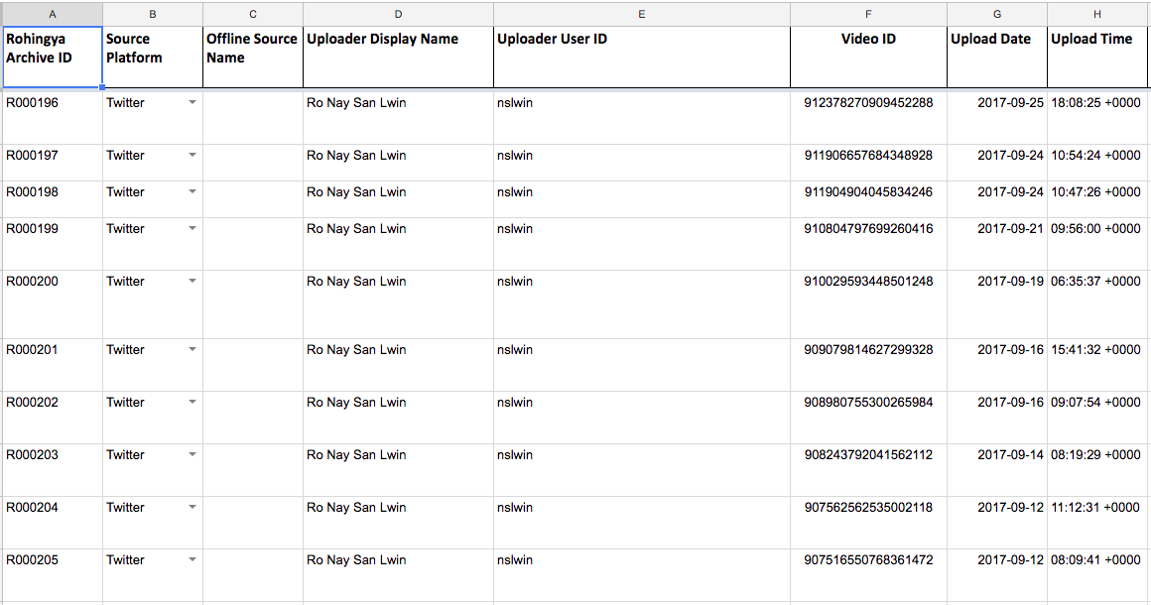
Cataloging

Slide 31
Where we’re at now
Policies, workflows and data dictionary are documented.
Continuing to build collection.
Exploring how collection can be used in investigative, accountability, and justice efforts.
Exploring how the collection can be made accessible to Rohingya community as a resource.
Exploring how to make workflow documentation accessible for others to use.

Slide 32
Needs / Gaps
For the most part, tools exist, but not all easy to use, or not all open source.
  GUIs for existing media + metadata collection tools and easy step-by-step guidance and/or recipes.
  Open source alternatives, e.g. to FileMaker [?]
WhatsApp metadata, strategies for collecting from closed networks.
Easy data modeling tools and walkthrough resources.
Identifying duplicate content across different format/files.

Slide 33
Thanks!
Witness.org | yvonne@witness.org | @ng_yvonne

